Slide 1
Serverless IT Support Ticketing System
AWS Lambda • API Gateway • DynamoDB • SNS • S3 • CloudWatch

Slide 2
Project Objective
- Build a fully serverless IT support ticket system.
- Users submit issues through a simple web interface.
- Backend automatically stores tickets and sends notifications.
- Reduce manual tracking and speed up IT response.

Slide 3
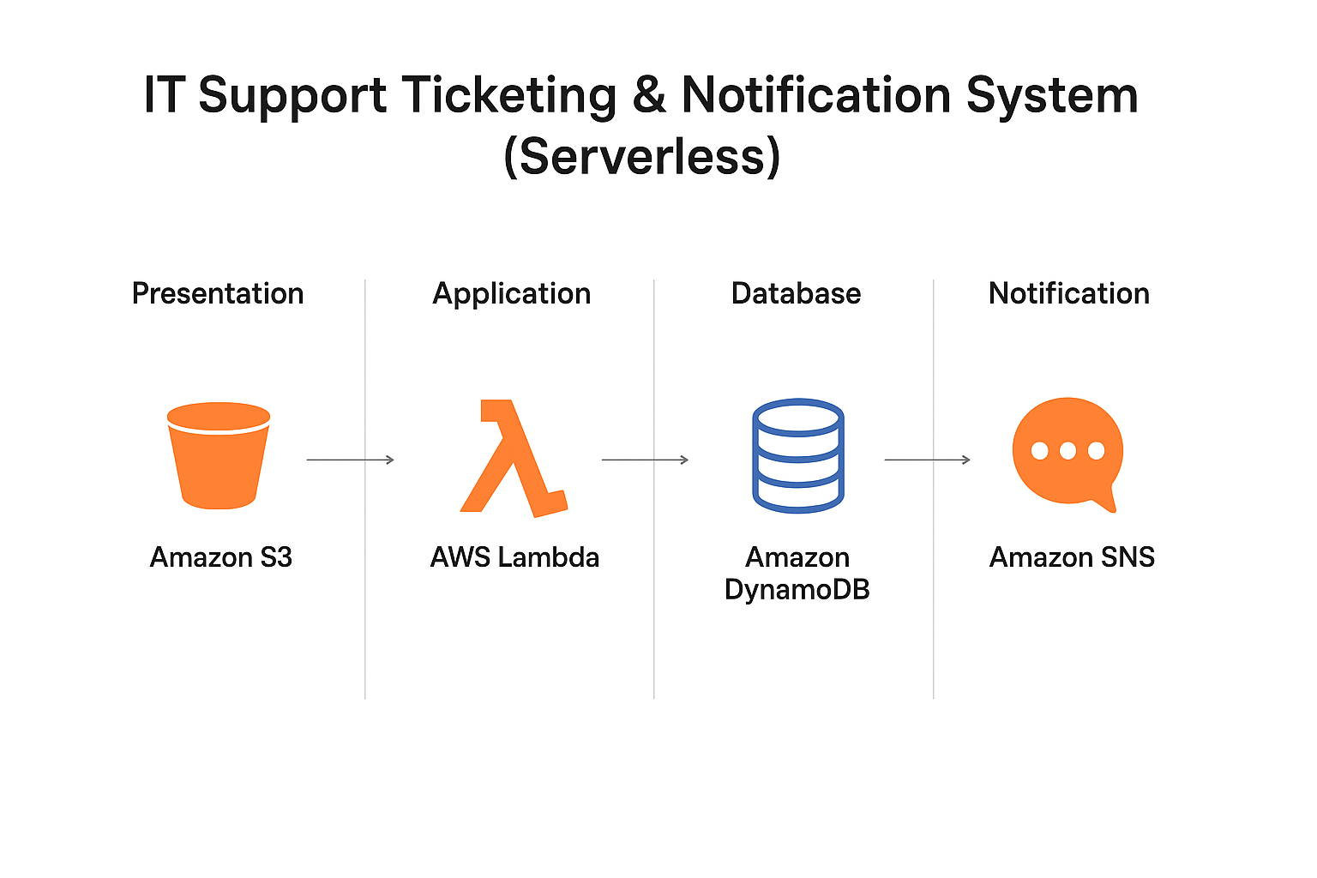

Slide 4
AWS Services Used
- Amazon S3: Hosts the frontend web form.
- API Gateway: Connects UI to backend API securely.
- AWS Lambda: Processes requests and creates tickets.
- DynamoDB: Stores ticket details.
- SNS: Sends email notifications for new tickets.
- CloudWatch: Logs and monitors Lambda execution.

Slide 5
Purpose & Use Cases
- Automates helpdesk ticket creation.
- Ensures instant IT team notification.
- Useful for organizations, colleges, startups.
- Tracks issues like login failures, system errors, access requests.

Slide 6
CORS (Cross-Origin Resource Sharing)
- Required when frontend and API are on different domains.
- Browser blocks API calls without CORS.
- API Gateway must allow the web page to call it.
- Enables safe interaction between S3 webpage and API.
- Fixes 'Network error: Failed to fetch' issues.

Slide 7
System Workflow
1. User submits a ticket on the S3 hosted webpage.
2. API Gateway receives the request.
3. Lambda processes data and generates a unique ticket ID.
4. DynamoDB stores ticket details.
5. Lambda triggers SNS.
6. SNS sends email notification to IT staff.

Slide 8
Implementation Steps
1. Create DynamoDB table (ticketId as primary key).
2. Create SNS topic + email subscription.
3. Develop Lambda function for ticket creation.
4. Configure API Gateway POST method.
5. Enable CORS on API.
6. Build & upload S3 HTML form.
7. Test end-to-end and verify notifications.

Slide 9
Advantages
- Fully serverless, low-cost system.
- Scales automatically with usage.
- Instant ticket notifications.
- No server maintenance.
- Easy to integrate with dashboards or analytics.

Slide 10
Conclusion
The Serverless IT Ticketing System automates IT support workflows using AWS.
It provides fast notifications, reliable data storage, and zero-maintenance operations.
Ideal for showcasing cloud and serverless skills.

